Slide 1
Threat Modeling
Offensive Security

Slide 2
What is threat modeling?
Determining threat scenarios that can lead to compromise of a system
Understanding the system
Thinking like an attacker
Devising a way in

Slide 3
Threat Modeling – Why?
Helps confirm to-be-implemented security features
Helps identify security gaps
Helps identify monitoring shortfalls and requirements
Helps identify vulnerabilities in the system
Helps identify additional test cases to verify the security of the system

Slide 4
PTES Threat Modeling
Gather relevant data
Identify and categorize primary and secondary assets
Identify and categorize threats and threat communities
Map threats to assets

Slide 5
Gathering relevant data
Everything about the business
Organizational structure
Processes
Sensitive information
Product details
Services rendered
Documentation on the business
OSINT sources
From the customer

Slide 6
Assets
Policies Plans Procedures
Intellectual Property, Trade secrets, R&D
Customer & employee data
Marketing information
Financial information

Slide 7
What would DSU consider assets?

Slide 8
What is a ”threat”?
Potential danger
Malicious intent
Accidental
Natural disaster
There doesn’t need to be a vulnerability for there to be a threat

Slide 9
Motivation
Why would someone target YOU?
As an organization
Profit
Hacktivism
Political
Competitor
Rep???

Slide 10
What threats does DSU face? Motivation?

Slide 11
NIST SP 800-30 R1
Guide for Conducting Risk Assessment
Frame risk
Provide context to how risk is assessed, monitored, and responded to
Assess risk
Identify threats, vulnerabilities, harm, and likelihood
Respond to risk
Develop a course of action, evaluate, and implement response
Monitor risk
Determine effectiveness of response, identify changes, verify responses are implemented

Slide 12
Threat
Event with the potential to negatively impact an organization
Denial of Service
Disclosure of information
Unauthorized access
Modification of information
Threats are carried out by a threat actor
Insider threat
Nation State
Script Kiddie
Hactivist group

Slide 13
Vulnerabilities
Weakness in a system
Can be exploited by a threat source
Software issues
Misconfigurations
Failover weaknesses
etc

Slide 14
Likelihood
What are the chances of the threat + vulnerability happening
Intent
Does exploiting this vulnerability meet the goals of the threat actor?
Capability
Does the threat actor have the means to exploit the vulnerability?
Targeting
Does your organization have something the threat actor wants?

Slide 15
Impact
The extent of the harm caused
How will it impact…
The business services
Reputation
Data
Financials
Think about the range and number of resources affected

Slide 16
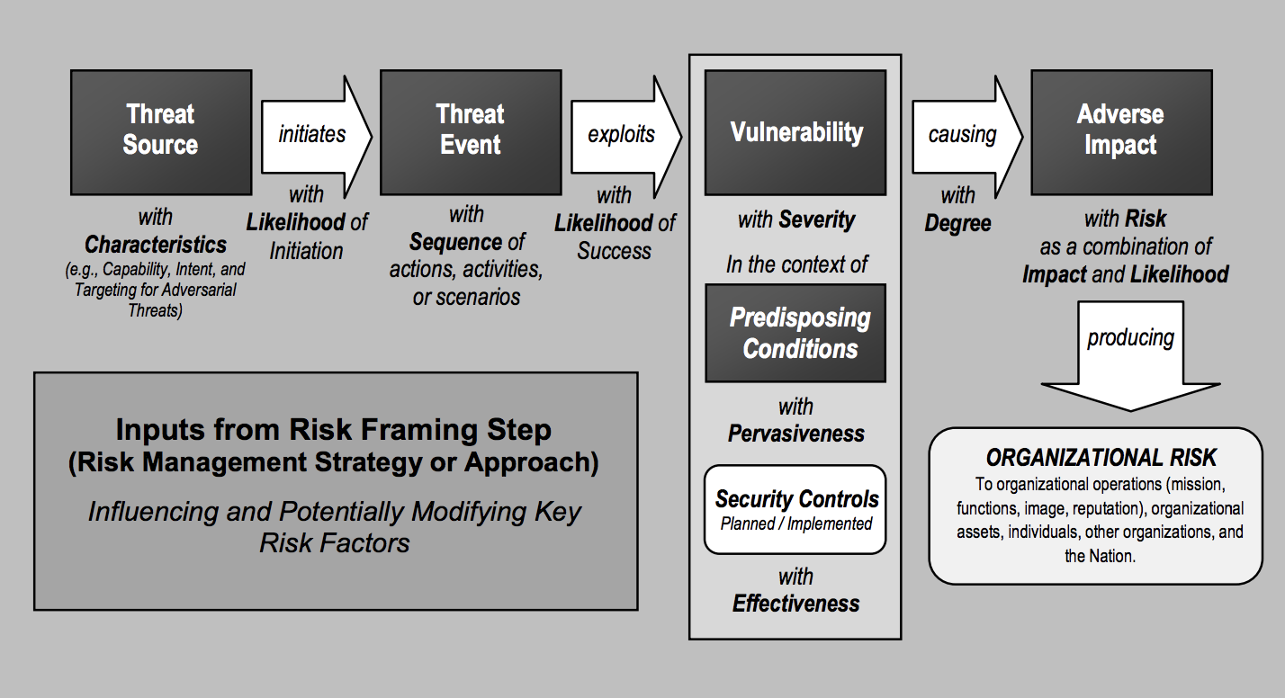
Risk Assessment Model

Slide 17
Assess Risk
Example of a risk?
__________
What is an associated vulnerability?
__________
What harm could be caused by the risk + vulnerability? Impact level?
__________
What is the likelihood of this occurring?
__________

Slide 18
Assess Risk
Example of a risk actor?
Hactivist group
What is an associated vulnerability?
Known vulnerability in apache
What harm could be caused by the risk + vulnerability?
Defaced website + decreasing reputation
Medium Impact
What is the likelihood of this occurring?
Likely – known vulnerability in publicly facing server

Slide 19
Poll poll.dakotastate.net
Rate the risk of the following: Unpatched EternalBlue vulnerability in an internal windows file server that contains proprietary product information
A. Low Likelihood, High Impact
B. Medium Likelihood, High Impact
C. High Likelihood, Low Impact
D. Medium Likelihood, Medium Impact
E. None of the above

Slide 20
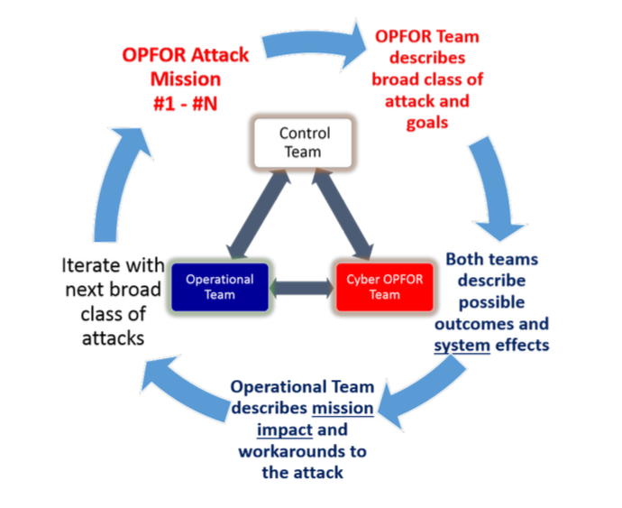
DoD Cyber Table Top
Scalable threat modeling to a given system

Slide 21
Cyber Table Top
Helps to better identify risks in a system or system of systems
Educates non-technical engineers, system owners, managers etc
Builds a more secure product or organization

Slide 22
Scoping
Still challenging
Time is always the issue
Cyber table top is flexible
System
System of systems
Better yet… both
Risk to organization all the way down to risk to a login process on a given system

Slide 23
OPFOR
OPFOR == Opposing Force
Develops attacks
Achieve missions based on kill chain
Can use known CVE, CWE, CAPEC’s
Emulates attacker based on TTP’s (Tools, Techniques, Procedures)
Script kiddie – Nation state
Is it a common tool in Kali, or difficult to custom develop
Notes:
Common Vulnerabilities and Exposures
Common Weakness Enumeration
Common Attack Pattern Enumeration and Classification

Slide 24
Operations Team
Blue teams
Defenders
System admins, engineers
Builders, maintainers
System users
Regular users of a system

Slide 25
DoD Cyber Table Top
Scalable threat modeling to a given system

Slide 26
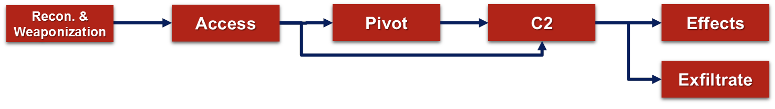
Simplified Kill Chain

Slide 27
Model the system
Identify trust boundaries
Firewalls are key
Separation of internet vs. secure servers network
Security zones within the internal network
Add actors, both internal and external
Note information flow especially between boundaries
Locate key assets in the network
Add impact value

Slide 28
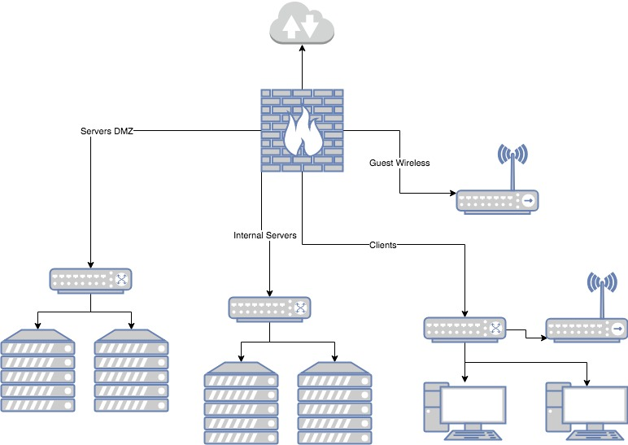
Example Network
Identify boundaries
Note information flow
Identify key assets
Where would impact be high? Low?

Slide 29
Example: Attack 1
Attack: Access
Attack Description: Malicious user will attempt to gain access to the network by sending phishing emails to users on the network. This will most likely result in low level user access to a domain connected system. In rare circumstances a privileged user may be compromised.
Assumption: Users will click on a phish.

Slide 30
Example: Attack 1
Attack cost and effort: Low, finding email addresses for a given organization is not challenging. Creating a phishing email is not difficult.
Likelihood: [Use scale of 1-5 with description] 5, High likelihood of a phish being clicked on by a user.
Result: User level access to the system
[IF ATTACK IS EFFECT OR EXFILTRATE] Impact: (How does this impact the organization in short and long term?

Slide 31
Other Ideas
Supply chain
Compromised hardware
Peripherals (keyboards, mice)
Physical access
USB Droppers
Wi-Fi
Web applications
VPN applications
Core business functions
Users
Which service they are the administrator of
Cyber-attack causing kinetic effects

